Slide 1
Change point support vector machine with l1 regularization
Ryan Lattanzi

Slide 2
Special thanks…
Dr. Abhishek kaul
Dr. Xiongzhi chen
Dr. Sergey lapin

Slide 3
The classification problem
Automated Decision Making
Prediction of qualitative outcomes
Spam filtering, Churn prediction, Sentiment Analysis, Dog Breed Detection, etc.
Algorithms? Take your pick…
Logistic Regression
Support Vector Machine
KNN
Naïve Bayes
Decision Tree
Neural Networks
Ensembles

Slide 4
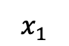
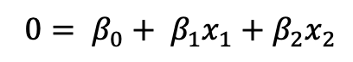
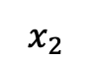
A quick illustration
$$x_{2}$$
$$x_{1}$$
$0= β_{0}+ β_{1}x_{1}+β_{2}x_{2}$

Slide 5
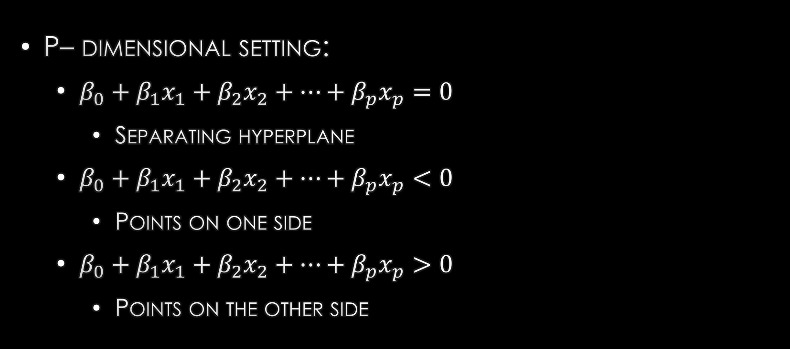
a natural extension
P– dimensional setting:
$β_{0}+β_{1}x_{1}+β_{2}x_{2}+…+β_{p}x_{p}=0$
Separating hyperplane
$β_{0}+β_{1}x_{1}+β_{2}x_{2}+…+β_{p}x_{p}<0$
Points on one side
$β_{0}+β_{1}x_{1}+β_{2}x_{2}+…+β_{p}x_{p}>0$
Points on the other side

Slide 6
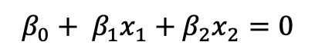
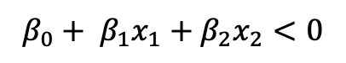
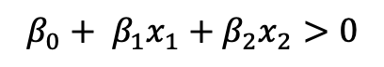
Back to the illustration
$$x_{2}$$
$β_{0}+ β_{1}x_{1}+β_{2}x_{2}>0$
$β_{0}+ β_{1}x_{1}+β_{2}x_{2}<0$
$$x_{1}$$
$β_{0}+ β_{1}x_{1}+β_{2}x_{2}=0$

Slide 7
Maximal margin classifier
$$x_{2}$$
$$x_{1}$$
These All Work!

Slide 8
The margin
Margin: Perpendicular distance between the separating hyperplane and the closest point to it
Denote it as ‘M’

Slide 9
The margin
$$x_{2}$$
M
$$x_{1}$$

Slide 10


construction
Setting:
$n$ training observations where $x_{1},x_{2},…,x_{n}∈ℝ^{p}$
Class labels $y_{1},y_{2},…,y_{n}∈\left\{−1,1\right\}$
$$x_{11}$$ | $$x_{12}$$ | $$x_{13}$$ | $$x_{14}$$ | $$x_{15}$$ | $$∙∙∙$$ | $$x_{1p}$$ | $$y_{1}$$
$$x_{21}$$ | $$x_{22}$$ | $$x_{23}$$ | $$x_{24}$$ | $$x_{25}$$ | $$∙∙∙$$ | $$x_{2p}$$ | $$y_{2}$$
$$x_{31}$$ | $$x_{32}$$ | $$x_{33}$$ | $$x_{34}$$ | $$x_{35}$$ | $$∙∙∙$$ | $$x_{3p}$$ | $$y_{3}$$
$$⋮$$ | $$⋮$$ | $$⋮$$ | $$⋮$$ | $$⋮$$ | $$⋮$$ | $$⋮$$ | $$⋮$$
$$x_{n1}$$ | $$x_{n2}$$ | $$x_{n3}$$ | $$x_{n4}$$ | $$x_{n5}$$ | $$∙∙∙$$ | $$x_{np}$$ | $$y_{n}$$

Slide 11
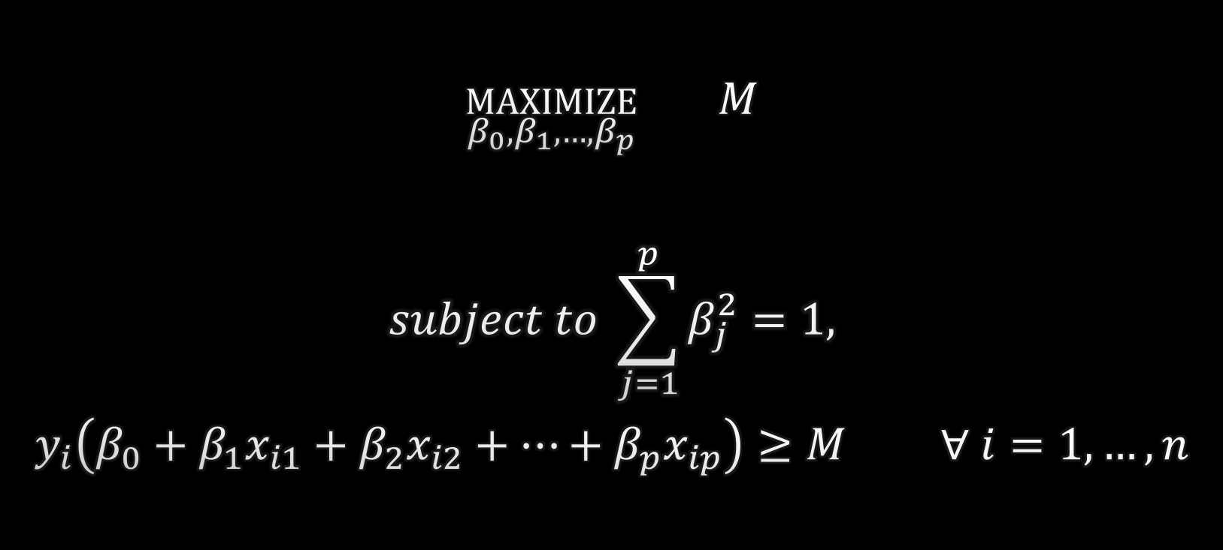
construction
$$\underset{β_{0},β_{1},…,β_{p}}{maximize}{ M}$$
$$subject to \sum_{j=1}^{p}{β_{j}^{2}}=1,$$
$$y_{i}\left(β_{0}+β_{1}x_{i1}+β_{2}x_{i2}+…+β_{p}x_{ip}\right)≥M ∀ i=1,…,n$$

Slide 12
Can we always find this solution?
N
O

Slide 13
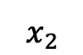
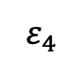
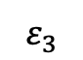
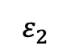
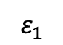
THE NON-SEPARABLE CASE
$$x_{2}$$
$$ε_{1}$$
$$ε_{2}$$
$$ε_{3}$$
$$ε_{4}$$
$$x_{1}$$

Slide 14
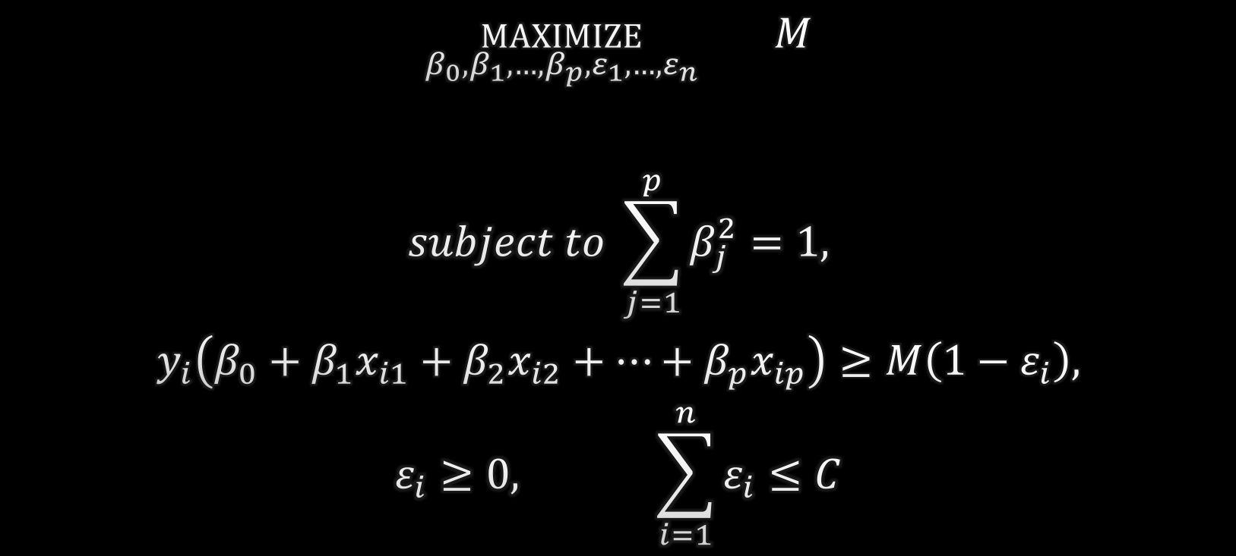
New optimization
$$\underset{β_{0},β_{1},…,β_{p},ε_{1},…,ε_{n}}{maximize}{ M}$$
$$subject to \sum_{j=1}^{p}{β_{j}^{2}}=1,$$
$$y_{i}\left(β_{0}+β_{1}x_{i1}+β_{2}x_{i2}+…+β_{p}x_{ip}\right)≥M\left(1−ε_{i}\right),$$
$$ε_{i}≥0, \sum_{i=1}^{n}{ε_{i}}≤C$$

Slide 15
Tuning the parameter c
Smaller C
$$x_{2}$$
$$x_{1}$$

Slide 16
Tuning the parameter c
$$x_{2}$$
Larger C
$$x_{1}$$

Slide 17
A Reminder
$$\underset{β_{0},β_{1},…,β_{p},ε_{1},…,ε_{n}}{maximize}{ M}$$
$$subject to \sum_{j=1}^{p}{β_{j}^{2}}=1,$$
$$y_{i}\left(β_{0}+β_{1}x_{i1}+β_{2}x_{i2}+…+β_{p}x_{ip}\right)≥M\left(1−ε_{i}\right),$$
$$ε_{i}≥0, \sum_{i=1}^{n}{ε_{i}}≤C$$

Slide 18
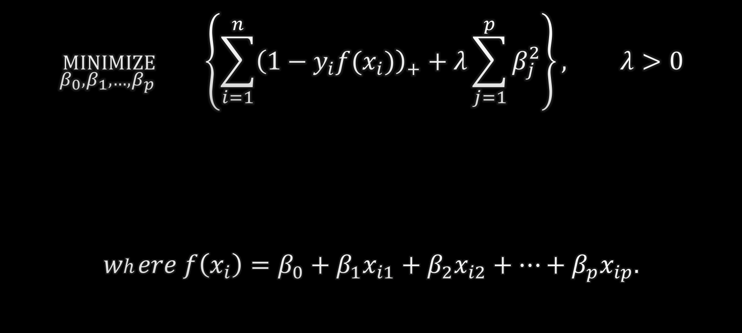
More nicerer…
Penalty
$$\underset{β_{0},β_{1},…,β_{p} }{minimize}{ \left\{\sum_{i=1}^{n}{{\left(1−y_{i}f(x_{i})\right)}_{+}+λ\sum_{j=1}^{p}{β_{j}^{2}}}\right\}}, λ>0$$
$$where f\left(x_{i}\right)=β_{0}+β_{1}x_{i1}+β_{2}x_{i2}+…+β_{p}x_{ip}.$$
Loss

Slide 19
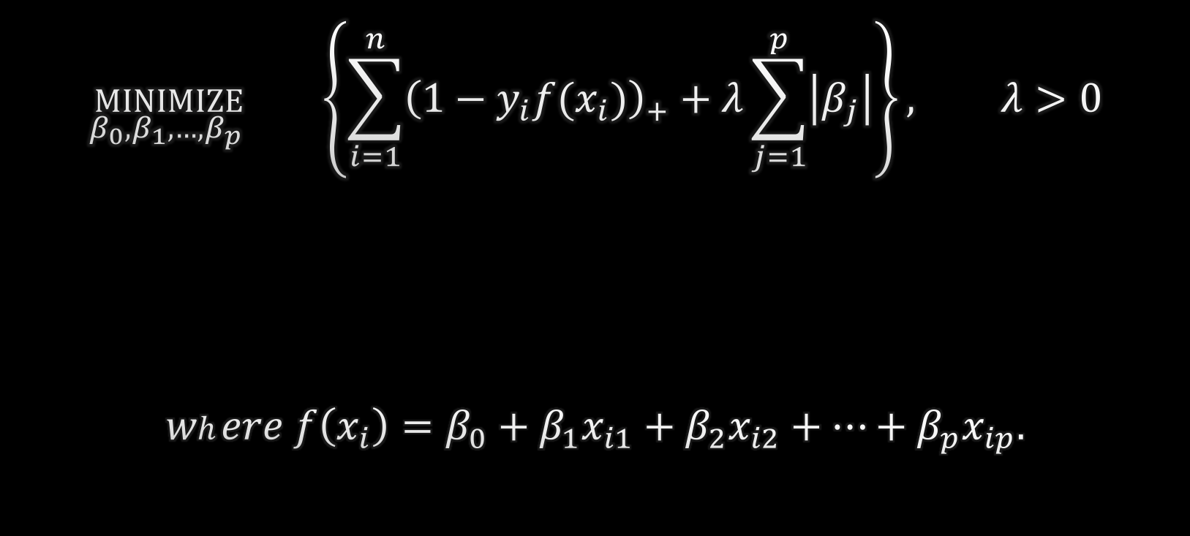
Shake it up a lil bit
$$\underset{β_{0},β_{1},…,β_{p} }{minimize}{ \left\{\sum_{i=1}^{n}{{\left(1−y_{i}f(x_{i})\right)}_{+}+λ\sum_{j=1}^{p}{\left|β_{j}\right|}}\right\}}, λ>0$$
$$where f\left(x_{i}\right)=β_{0}+β_{1}x_{i1}+β_{2}x_{i2}+…+β_{p}x_{ip}.$$

Slide 20

Why??
The high-dimensional case
$p≈n$
$p>n$
$p≫n$
$$x_{11}$$ | $$x_{12}$$ | $$x_{13}$$ | $$x_{14}$$ | $$x_{15}$$ | $$∙∙∙$$ | $$x_{1p}$$ | $$y_{1}$$
$$x_{21}$$ | $$x_{22}$$ | $$x_{23}$$ | $$x_{24}$$ | $$x_{25}$$ | $$∙∙∙$$ | $$x_{2p}$$ | $$y_{2}$$
$$x_{31}$$ | $$x_{32}$$ | $$x_{33}$$ | $$x_{34}$$ | $$x_{35}$$ | $$∙∙∙$$ | $$x_{3p}$$ | $$y_{3}$$
$$⋮$$ | $$⋮$$ | $$⋮$$ | $$⋮$$ | $$⋮$$ | $$⋮$$ | $$⋮$$ | $$⋮$$
$$x_{n1}$$ | $$x_{n2}$$ | $$x_{n3}$$ | $$x_{n4}$$ | $$x_{n5}$$ | $$∙∙∙$$ | $$x_{np}$$ | $$y_{n}$$

Slide 21
Whew…intermission?

Slide 22
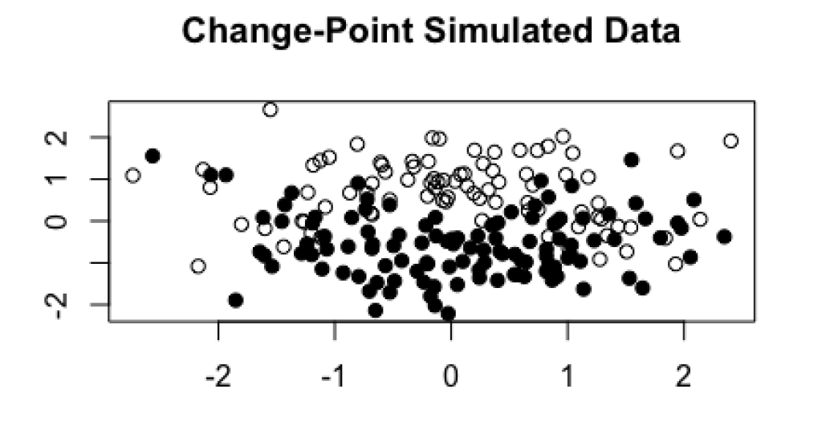
The changepoint problem

Slide 23
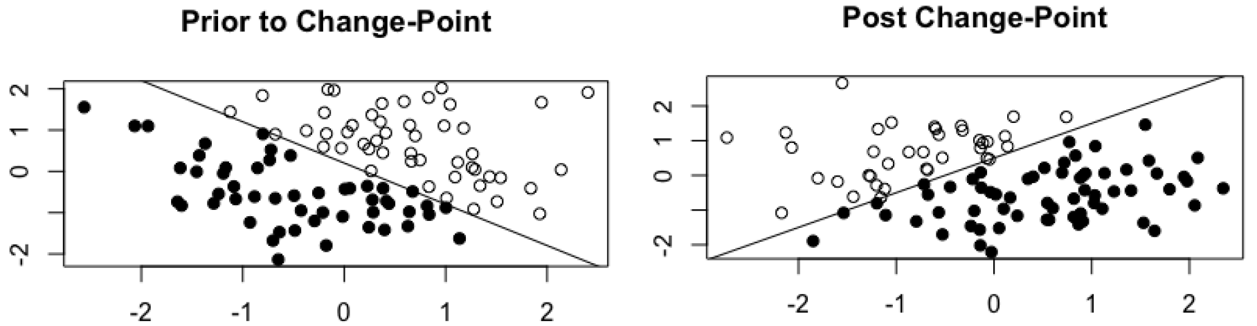
The changepoint problem

Slide 24
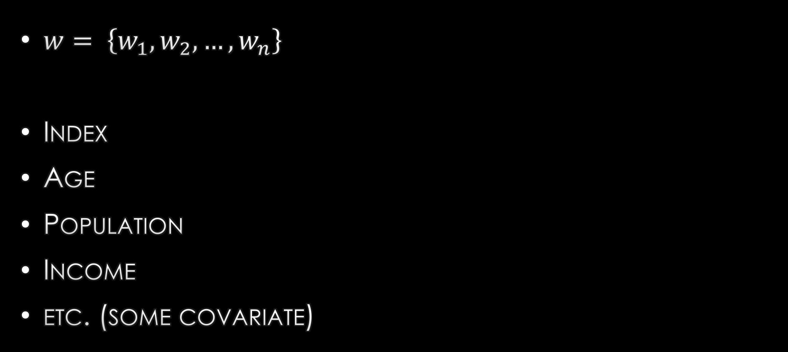
The change inducing variable
$w= \left\{w_{1},w_{2},…,w_{n}\right\}$
Index
Age
Population
Income
etc. (some covariate)

Slide 25


The change inducing variable
$$\left\{i∈\left\{1,…,n\right\} | w_{i}≤τ_{0}\right\}$$
$$\left\{i∈\left\{1,…,n\right\} | w_{i}>τ_{0}\right\}$$
** Notation ** $τ_{0}$ is our true change point

Slide 26

goal
Find the changepoint over our change inducing variable (if it exists) and fit two L1 regularized SVMs: one on the data before the changepoint, and one on the data after the changepoint
$$\underset{β_{0},β_{1},…,β_{p} }{minimize}{ \left\{\sum_{i=1}^{n}{{\left(1−y_{i}f(x_{i})\right)}_{+}+λ\sum_{j=1}^{p}{\left|β_{j}\right|}}\right\}}, λ>0$$
$$where f\left(x_{i}\right)=β_{0}+β_{1}x_{i1}+β_{2}x_{i2}+…+β_{p}x_{ip}.$$

Slide 27

Current methods
Full grid search
Search over a grid of potential split points, updating our model each time to find the optimal model
Pros
Globally optimal results
Cons
Requires $n$ model updates
Exhaustive and inefficient with big data

Slide 28






Our Proposed Method
$$β$$
$$γ$$
$$τ_{0}$$
$$τ^{(0)}$$
$$β^{(0)}$$
$$γ^{(0)}$$

Slide 29
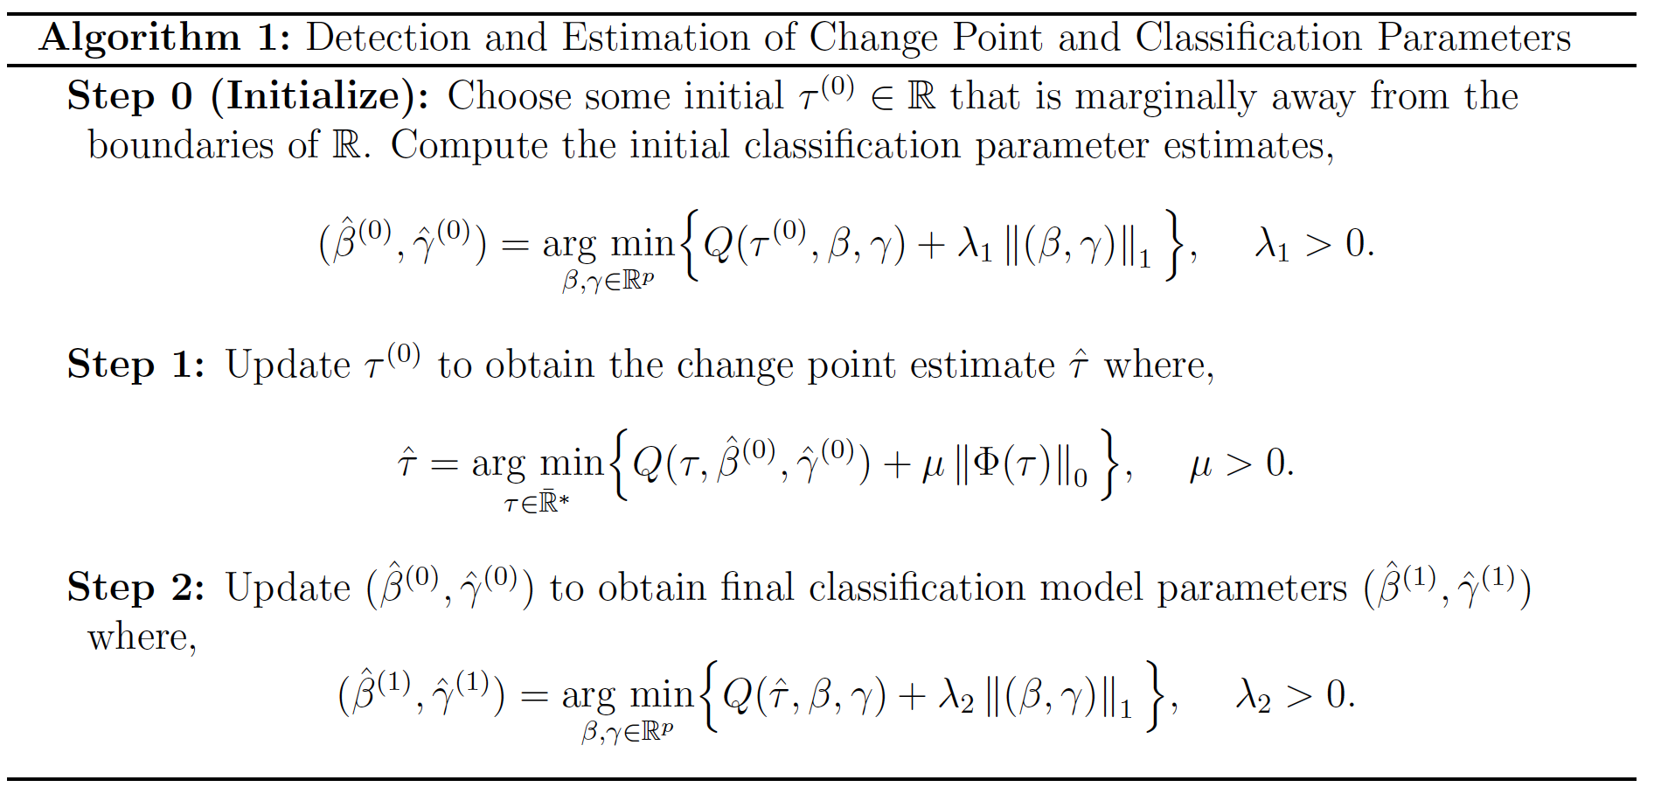
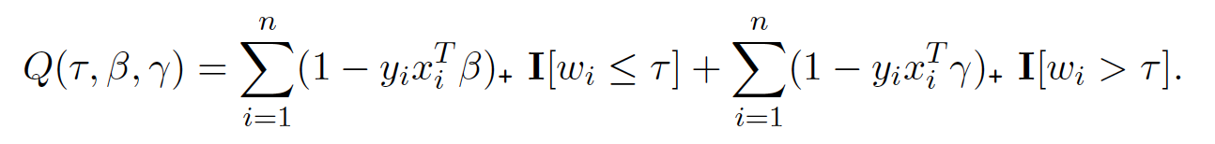
Formally…

Slide 30
Our proposed method
Pros
Only one model update
Results as good as full grid search approach (verification found in [1])
Cons
???

Slide 31
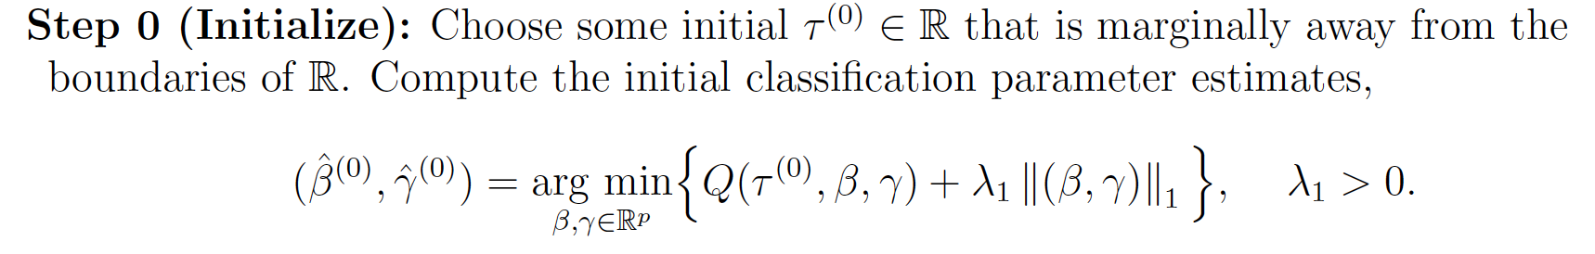
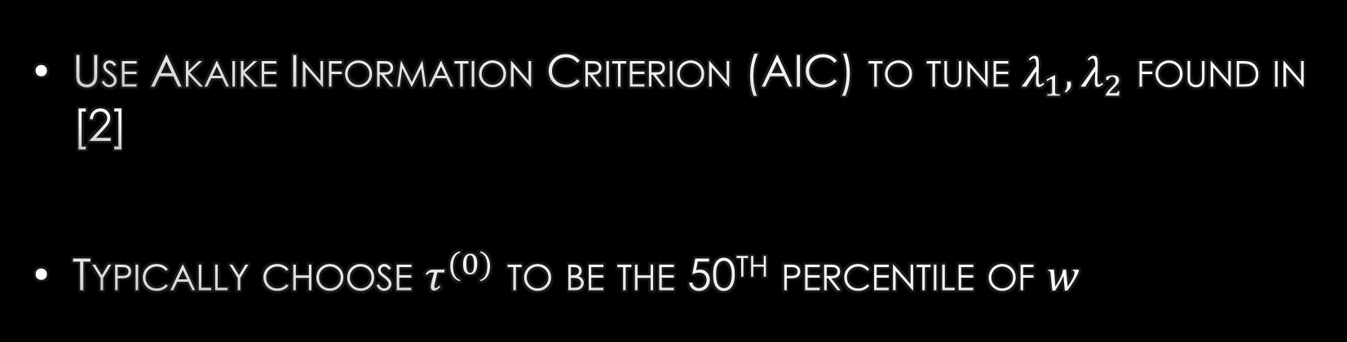
Technical details
Use Akaike Information Criterion (AIC) to tune $λ_{1},λ_{2}$ found in [2]
Typically choose $τ^{(0)}$ to be the 50th percentile of $w$

Slide 32
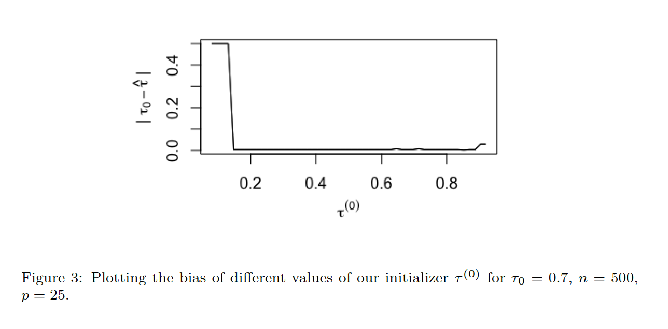

Slide 33
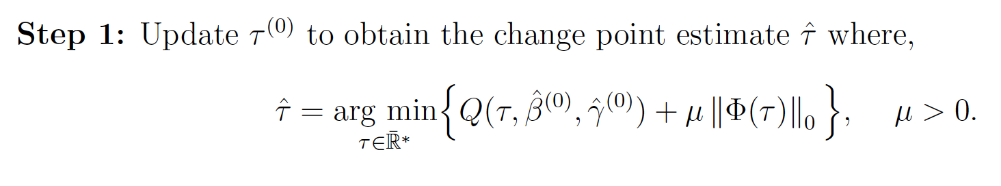
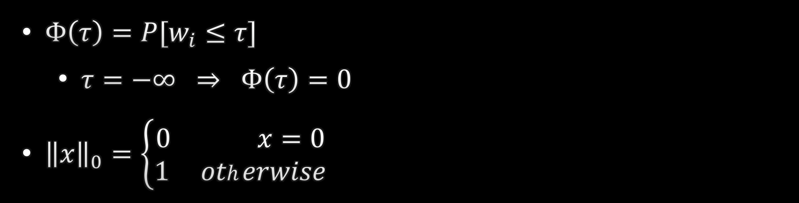

Technical details
$Φ\left(τ\right)=P[w_{i}≤τ]$
$τ=−∞ ⇒ Φ\left(τ\right)=0$
${\left\|x\right\|}_{0}=\left\{\begin{aligned}0 x=0 \\ 1 otherwise\end{aligned}\right.$
$$Q\left(τ,β,γ\right)=\sum_{i=1}^{n}{{(1−y_{i}x_{i}^{′}γ)}_{+}}$$

Slide 34

Technical details
Use Bayesian Information Criterion (BIC) to tune $μ$
Search space for $τ$ is really $\left\{−∞\right\}∪w$

Slide 35
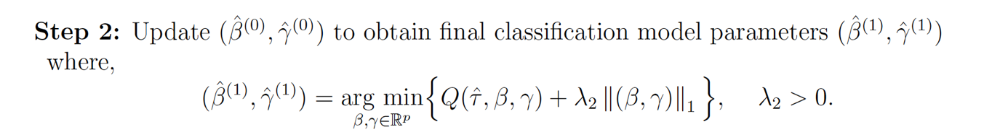
Technical Details

Slide 36

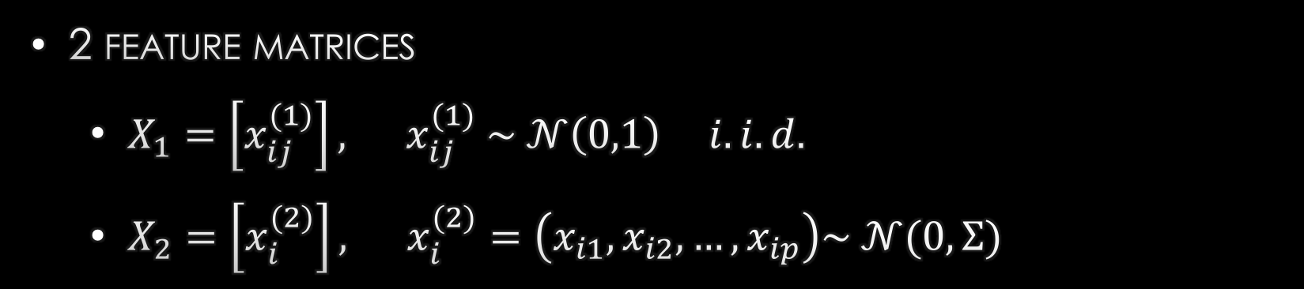

Simulation Setup
2 feature matrices
$X_{1}=\left[x_{ij}^{(1)}\right], x_{ij}^{(1)} \sim 𝒩\left(0,1\right) i.i.d.$
$X_{2}=\left[x_{i}^{(2)}\right], x_{i}^{(2)}=\left(x_{i1},x_{i2},…,x_{ip}\right)\sim 𝒩(0,Σ)$
$$1$$ | $$0.5$$ | $${0.5}^{2}$$ | $$…$$ | $${0.5}^{(p−1)}$$
$$0.5$$ | $$1$$ | $$0.5$$ | $$…$$ | $${0.5}^{(p−2)}$$
$${0.5}^{2}$$ | $$0.5$$ | $$1$$ | $$…$$ | $${0.5}^{(p−3)}$$
$$⋮$$ | $$⋮$$ | $$⋮$$ | $$⋱$$ | $$⋮$$
$${0.5}^{(p−1)}$$ | $${0.5}^{(p−2)}$$ | $${0.5}^{(p−3)}$$ | $$…$$ | $$1$$
$$Σ=$$

Slide 37
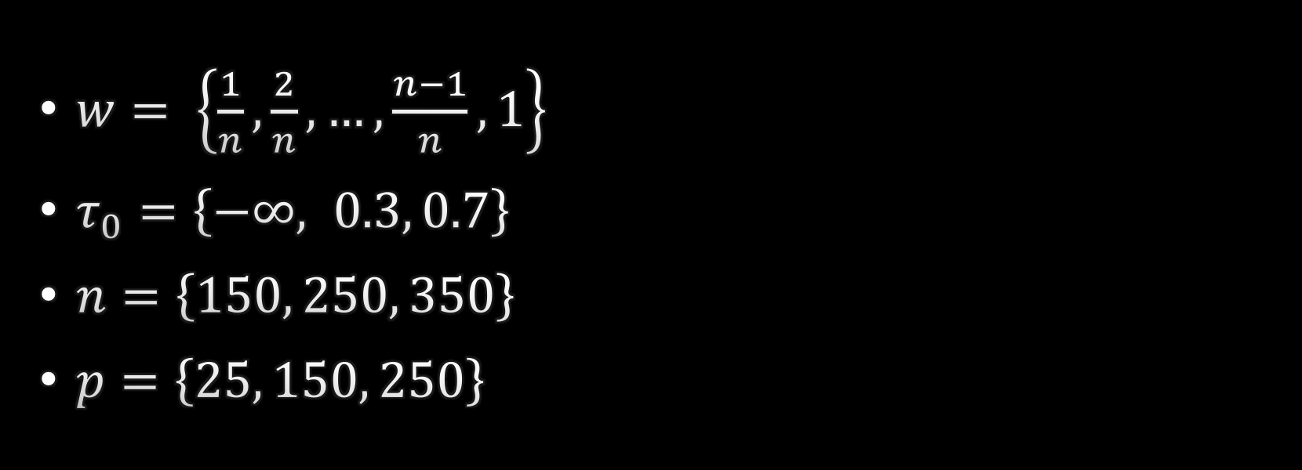
Simulation setup
$w= \left\{\frac{1}{n},\frac{2}{n},…,\frac{n−1}{n},1\right\}$
$τ_{0}=\left\{−∞, 0.3, 0.7\right\}$
$n=\left\{150, 250, 350\right\}$
$p=\left\{25, 150, 250\right\}$

Slide 38
Compare With
L1 Regularized Linear SVM over the entire dataset
Nonlinear SVM (radial basis kernel) over the entire dataset

Slide 39
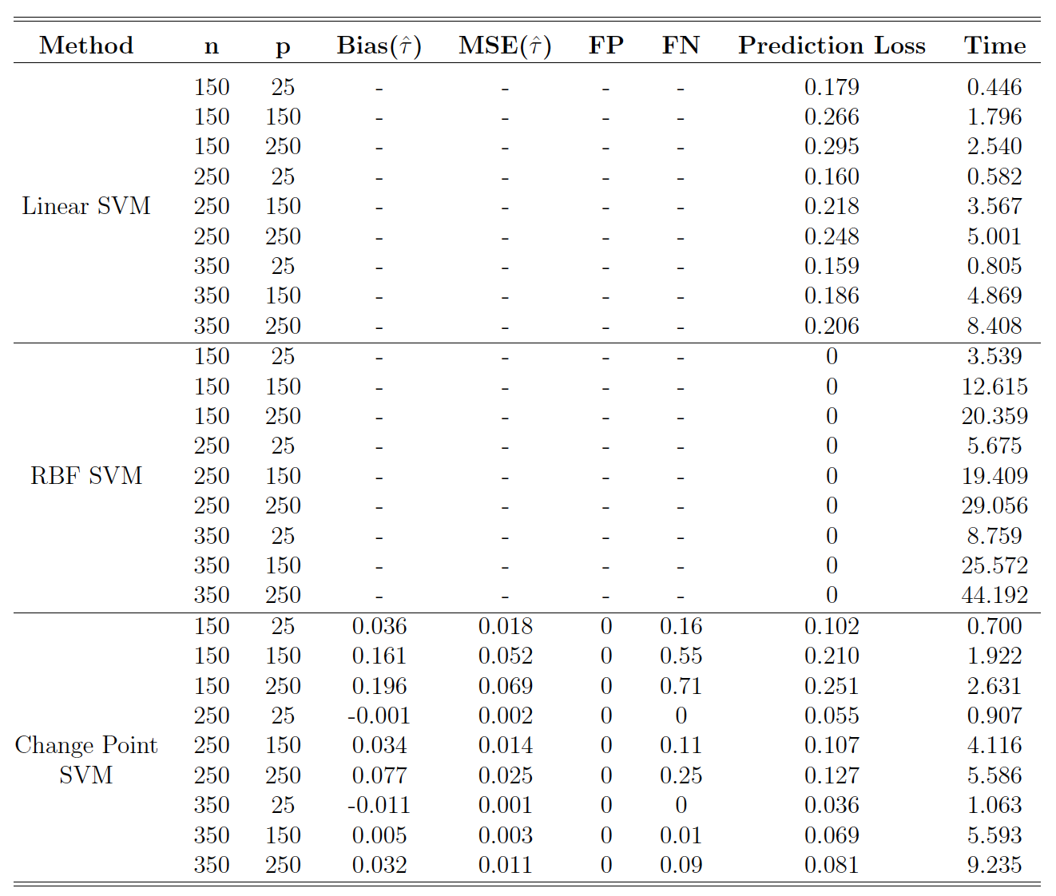

results
$$X_{1}$$
$$τ_{0}=0.7$$

Slide 40
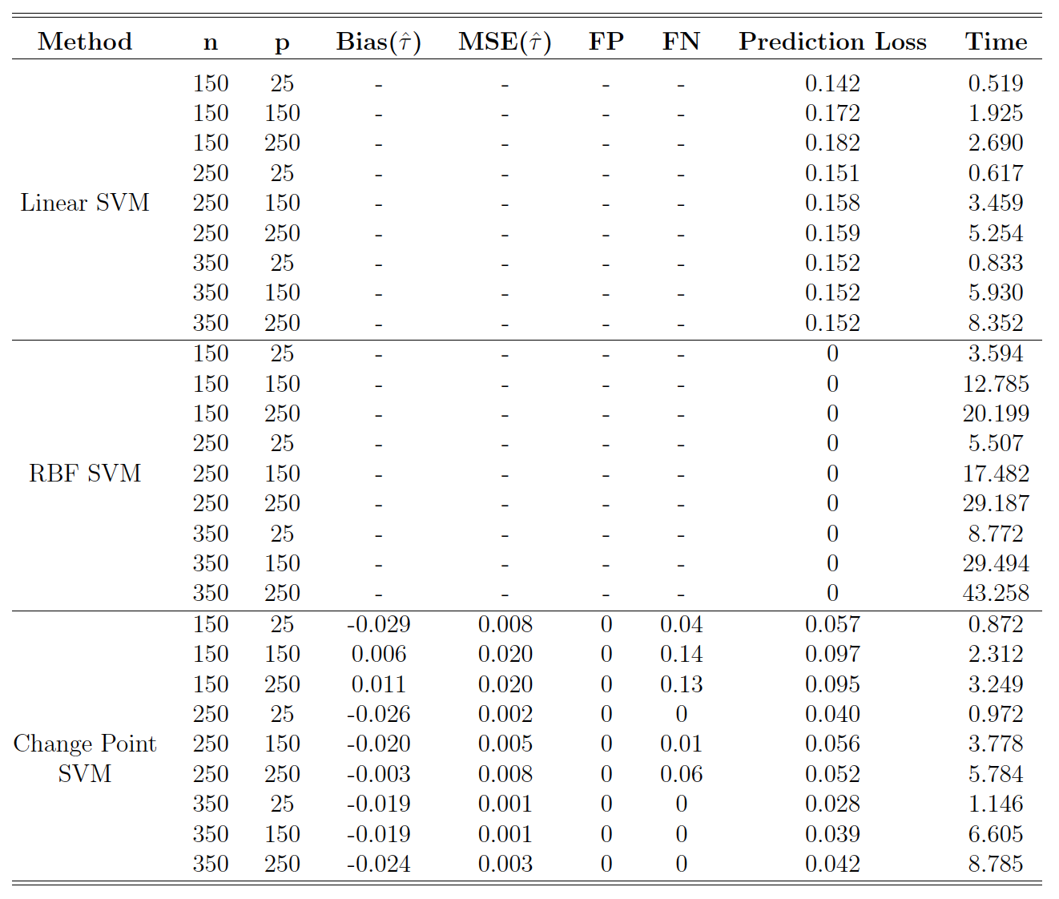

Results
$$X_{2}$$
$$τ_{0}=0.7$$

Slide 41
Questions?
THANK YOU!

Slide 42
Sources
[1] Kaul, A., Jandhyala, V. and Fotopoulos, S. (2019) An efficient two step algorithm for high dimensional change point regression models without grid search. Journal of Machine Learning Research 1.
[2] Claeskens, G., Croux, C. and Kerckhoven, J. (2008) An Information Criterion for Variable Selection in Support Vector Machines. Journal of Machine Learning Research 9.

